Slide 1


Urinary Tract Infections

Slide 2
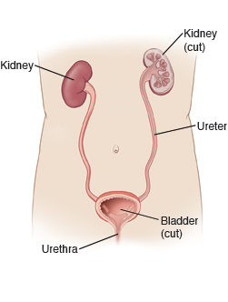
Overview
The role of the urinary tract is make and store urine.
A urinary tract infection(UTI) is a infection involving the any part of the urinary system (kidneys, ureters, bladder, urethra).
Most common are infections involving the lower tract- the bladder and urethra.
About 60% of women and 12% of men will have at least 1 UTI in their lifetime.
Notes:
The kidneys filter waste from the blood and it is removed in the form of urine. Things like sodium, calcium and potassium are balanced through the kidneys. More serious complications if spreads to the kidneys. Making it easier for organisms to reach the tract

Slide 3
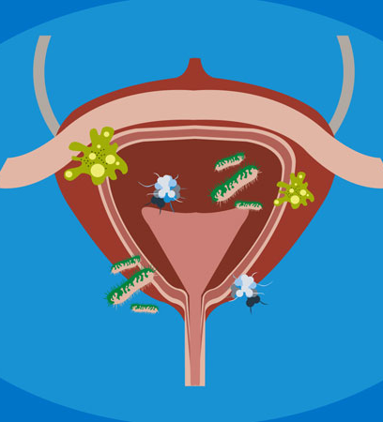
Causes & Risk Factors
UTI’s are caused by bacteria entering through the urethra and multiplying in the bladder.
Risk factors include:
  Gender
  Birth control/ hormonal changes
  Abnormal anatomy or structure changes
  Chronic health conditions
  Age
  Poor hygiene
  Sexual intercourse
Notes:
Normal urine has no bacteria in it. Some people are more prone to get utis than others. Women are at a bigger risk due to having a shorter urethra. Menopause can lower the estrogen levels, making it easier to get a uti. Dm-high blood sugar in the urine and immune system being lowered.

Slide 4
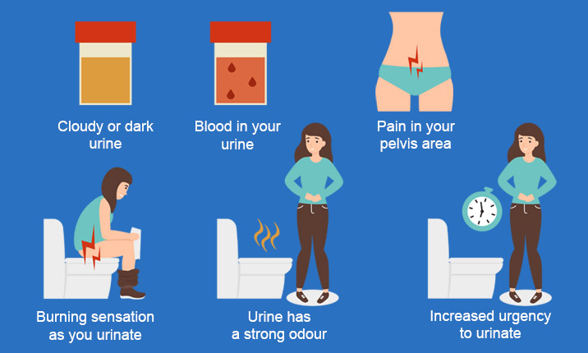
Symptoms
A persistent urge to urinate
Burning with urination
Small amounts, frequently
Signs of blood in the urine
Strong/foul smell
Pelvic pain-for women
Cloudy urine
Notes:
Uti- linning of the bladder and urethra get red in irritated- similar to when you have a sore throat. Feeling like you are not able to fully empty your bladder

Slide 5
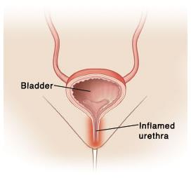
Specific Symptoms to Affected Parts of the Urinary Tract
Urethra (urethritis)
Bladder (cystitis)
Discharge
Burning/ pain with urination
Pelvic pressure
Presence of blood in urine
Lower abdominal pain
Frequent/painful urination

Slide 6
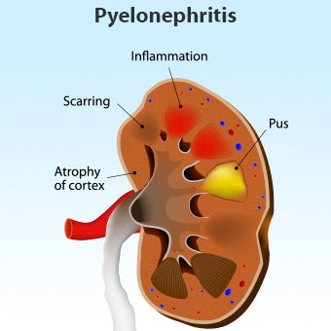
Continued: Affected Parts
Kidneys (pyelonephritis)
  Mid/lower back & side(flank) pain
  Fever
  Chills
  Nausea and vomiting
Notes:
More serious bc you can end up with permant kidney damage if left untreated

Slide 7
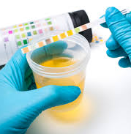
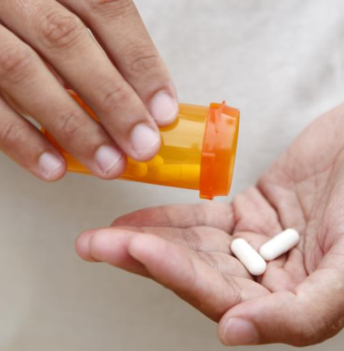
Diagnosis & Treatment
A UTI can usually be diagnosed by your health care provider with a simple urine sample and physical exam.
A CT scan may be needed for further evaluation if the upper tract is thought to be infected or to see if a kidney stone is present.
Most commonly a UTI can be cleared up by taking a course of antibiotics.
Notes:
If you get 3 or more a year, your dr may want to do more testing and you may be placed on a longer course of a low dose antibiotic

Slide 8

Prevention
Have adequate water intake
Do not hold urine in your bladder
Urinate after sexual activity
Females-wipe front to back
Take showers instead of baths
Fully empty your bladder each time you urinate
Notes:
6-8 8oz water/day. Cranberry pills and juice is talked about but research has shown that it doesn’t help if you already have developed an infection

Slide 9
References
Urinary tract infections (UTI). Mayo Clinic. https://www.mayoclinic.org/diseases-conditions/urinary-tract-infection/symptoms-causes/syc-20353447. Accessed December 7,2020.
Urinary Tract Infections in Adults. Urology Care Foundation. https://www.urologyhealth.org/urology-a-z/u/urinary-tract-infections-in-adults. Accessed December 7,2020.
Urinary Tract Infections. Centers for Disease Control and Prevention. https://www.cdc.gov/antibiotic-use/community/for-patients/common-illnesses/uti.html. Accessed December 8, 2020.
Bladder Infection (Urinary Tract Infection-UTI) in Adults. National Institute of Diabetes and Digestive and Kidney Disease. https://www.niddk.nih.gov/health-information/urologic-diseases/bladder-infection-uti-in-adults. Accessed December 8, 2020.

