Slide 1


S l e e p & s l e e p d I s o r d e r s

Slide 2
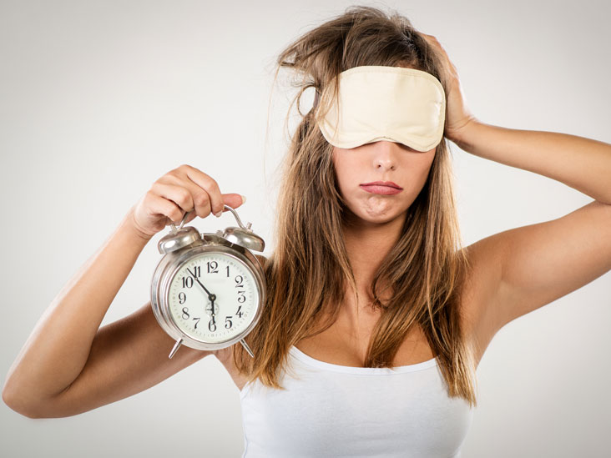
Facts
50-70 million Americans have a chronic sleep disorder
Sleep deficiency is linked to multiple heart conditions like heart disease, high blood pressure. Also depression, diabetes and obesity
1/3 of adults normally get less than the recommended amount of sleep.
Notes:
As well as Kidney disease, dm type 2- affects how your body reacts to insulin- usually linked to obesity. Recommended amount is at least 7 hrs for adults. Also affects immune system-unable to fight common colds as easily

Slide 3

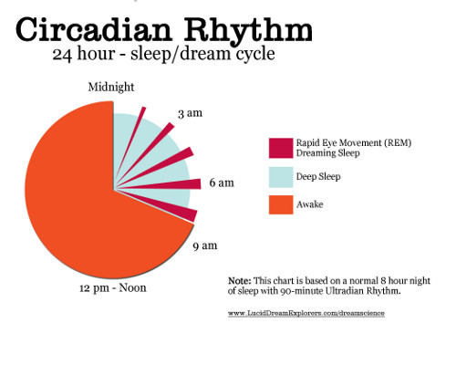
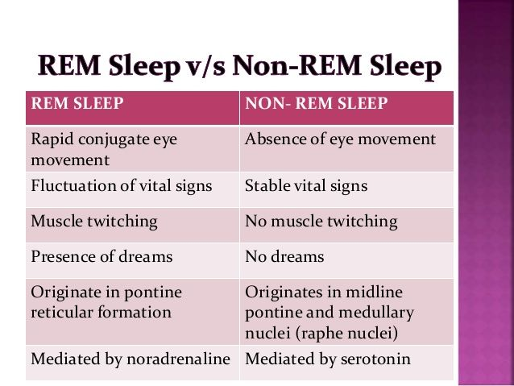
What is REM sleep?
REM stands for Rapid Eye Movement.
You typically cycle between REM and Non-REM sleep 3-5 times during the night
REM first occurs about 90 min after falling asleep
Notes:
A circadian rhythm is your bodys natural clock. Body temp, metabolism and release of hormones. Feeling rested depends not only on the number of hours of sleep you are getting but also how much of each type of sleep. Melatonin-a hormone is released once it starts to get dark. It makes you start to feel drowsy and help prepare the body for sleep. Cortisol does the opposite and is released once the sun starts to come out- helping your body wake up. As you get older, you spend less time in REM sleep

Slide 4
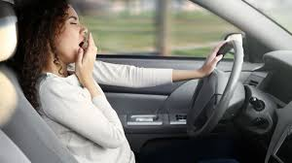
Drowsy driving
Driving while feeling sleepy or fatigued
Similar to driving drunk- being awake for 18hrs is similar to having a blood alcohol content of 0.05%
Estimated that 1,500 fatal crashes each year are caused by drowsy drivers
Who’s more likely to drive drowsy? Shift workers, those not getting enough sleep, undiagnosed sleep disorders, taking certain medications
Notes:
For reference-The legal limit is 0.08% Less attentive, slow reaction time, affects decision making ability. –mistakes at work Shift workers –nightime or those that work long shifts.

Slide 5

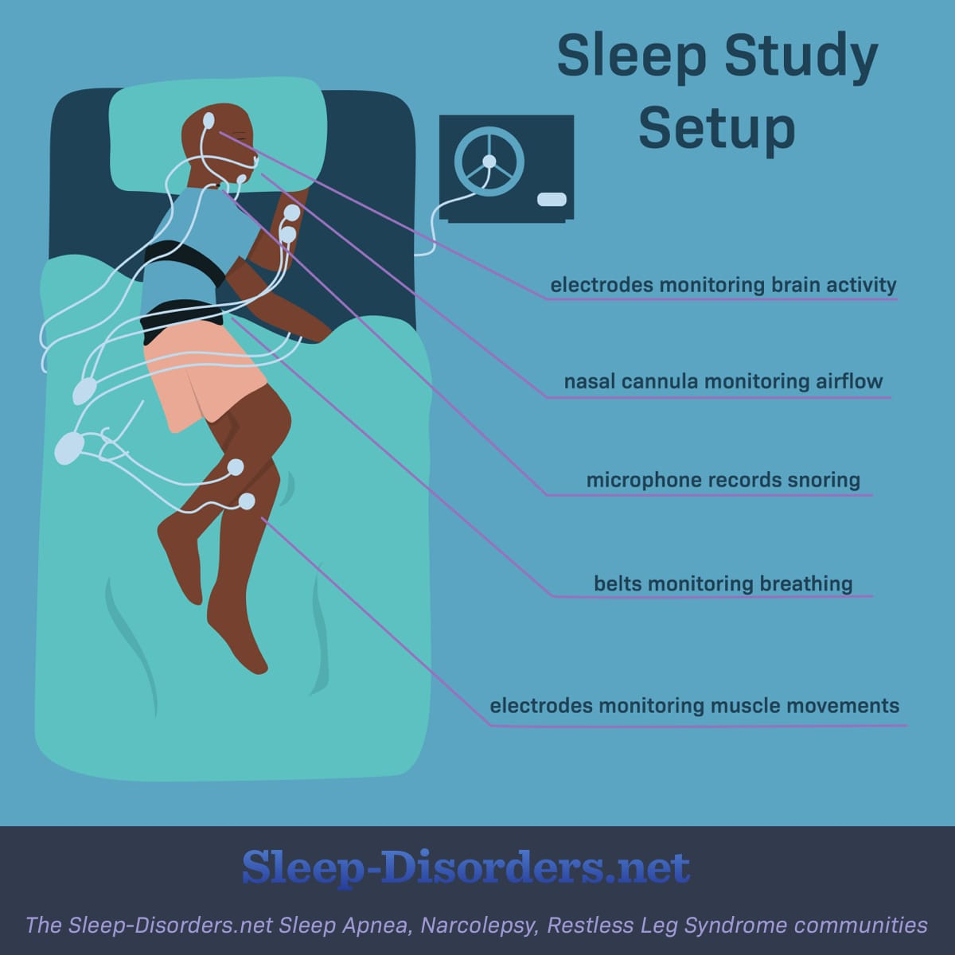
Sleep disorders
Insomnia-problem falling asleep or staying asleep
Narcolepsy-extreme sleepiness and falling asleep suddenly during the day.
Restless leg syndrome(RLS)- a sensation or urge to move your legs making it hard to fall asleep
Sleep apnea-abnormal breathing patterns while you sleep
Notes:
People with Narcolepsy are also known to have extreme muscle weakness. Rls to some feels like an aching pain that goes away with movement of the legs-kicking or walking. is characterized as a sleep movement disorder. Apnea-snoring/gasping, pauses in breathing. Many more sleep disorders(sleep walking, sleep paralysis, night terrors), these are the most common. Most of these disorders can be treated once they are properly diagnosed by your dr-such as a sleep study-as shown above it will monitor a multitude of things-brain waves, breathing, movement. Cpap, medications, schedule/behavior alteratations.

Slide 6
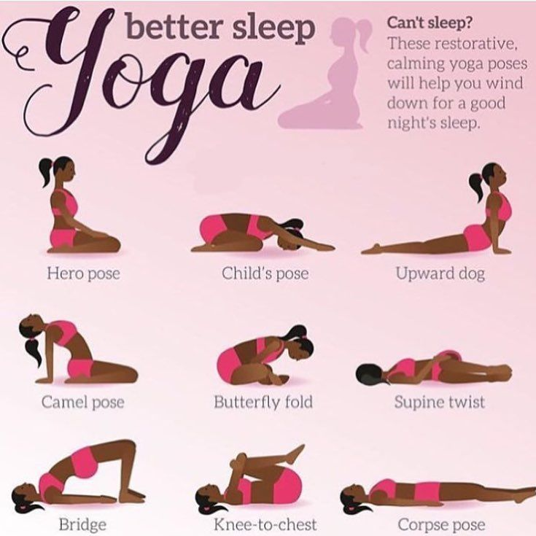
Tips for better sleep
Go to bed at the same time every night
Create a dark, quiet, slightly cooler room
Avoid using electronics at least 30 min prior to bedtime
Reduce your fluid intake
Avoid caffeine, alcohol, nicotine and large meals
If you do not fall asleep with in 20 mins of getting into bed-get up
Keep a sleep diary for 2 weeks
Notes:
Be consistent even on weekends and vacation. Aim for at least 7 hrs. also with the electronics, avoid bright lights. Start to dim or turn lights off To avoid having to get up to use the bathroom. Later in the afternoon and esp evening. Keep in mind that caffeine can have effects for up to 8 hrs The theory is that you want your body to associate the bed with sleeping. Avoid reading in bed. Record the time you wake up and go to bed, naps, exercise, medications, what and when meals and drinks were consumed

Slide 7
References
Sleep and Sleep Disorders. Center of Disease Control and Prevention. https://www.cdc.gov/sleep/about_sleep/key_disorders.html. Accessed Aug 31,2020.
Sleep Disorders. Mayo Clinic. https://www.mayoclinic.org/diseases-conditions/sleep-disorders/symptoms-causes/syc-20354018. Accessed Aug 31, 2020.
Sleep Deprivation and Deficiency. National Heart, Lung and Blood Institute. https://www.nhlbi.nih.gov/health-topics/sleep-deprivation-and-deficiency. Accessed Sep 2,2020.
Brain Basics: Understanding Sleep. National Institute of Neurological Disorders and Stroke. https://www.ninds.nih.gov/Disorders/patient-caregiver-education/Understanding-sleep. Accessed Sep 3,2020.

Slide 8


Ph: (951) 732-7970 | HealthServices@msjc.edu | www.msjc.edu/healthcenter/
Follow us on Social Media @MSJChealth

