Slide 1

Sexually Transmitted Diseases

Slide 2

Did you know?
Also called Sexually transmitted infection (STI)
Infections that are spread from one person to another during vaginal, anal or oral sex
15-24 year olds are ¼ of active population but = ½ of the 20 million STDs that occur each year in the United States
More than 30 different bacteria/viruses/parasites that are known to be transmitted through sexual contact
Notes:
We are going to talk about the top 8

Slide 3
Types of STDs
Gonorrhea
Heavy menstrual bleeding or bleeding between periods
Painful bowel movements
Anal itching
Chlamydia
Lower abdominal pain
Pain during intercourse in women
Bleeding between periods in women
Trichomoniasis
Strong vaginal odor
Vaginal itching or irritation
Itching or irritation inside the penis
Pain during intercourse
Curable
Notes:
Pain /burning while urinating, discharge from penis or vagina(cloudy/white, green, yellow)bloody, painful/swollen testicles for men. Gon-roughly 10 days, Chl-1-3 weeks, Trich-men do not normally show any symptoms. 5-28 days after exposed

Slide 4
Syphilis
Early stage symptoms:
a small sore may be present at the site of infection
Symptoms can progress to:
Rash, small sores over any area of your body
Fever
Fatigue/aching
Symptoms if it goes untreated:
Lack of coordination
Numbness
Dementia/behavior changes
Headache
Notes:
Syphilis is a bacterial infection and is the last curable STD we will talk about, however it gets its own slide bc of complexity, it can occur in multiple stages. Sores-usually painless usually the genitals, rectum, tongue or lips. Rash/sores-including your palms and soles. Extreme cases-Paralysis &Blindness
Neuro-can happen at any stage. Affects the nervous system

Slide 5
Types
Herpes
Small red bumps/ blisters/ open sores in the genital area
Pain or itching around the genital area
Human papillomavirus (HPV)
Several warts clustered together
Skin tone or gray in color in the genital area
HIV
Mild, flu like symptoms early on
Fever, weight loss, swollen lymph nodes
Late stage includes headaches, chronic diarrhea, night sweats
Hepatitis B
Nausea/ vomiting
Abdominal pain
Dark urine
Yellowing of your skin and the whites of your eyes (jaundice)
Incurable
Notes:
Herpes is highly contagious, people may have it and not know, others have re occurring episodes/breakouts. Urination can be painful d/t the open sores. HPV- different types, some can cause cervical cancer and others can cause genital warts. that take on a cauliflower shape HIV- early symptoms can last a week to a month=highly contagious during this time. After these symptoms pass, it can be 10 + yrs before other symptoms appear. The late stages-fever that last weeks at a time, swollen lymph nodes for mult months, unusual infections-as the virus cont to attack the immune system. Hep b- discomfort, especially in the area of your liver on your right side beneath your lower ribs, itching d/t unable to filter out bilirubin-substance made during breakdown of red blood cells

Slide 6

Why is this important?
Many STDs show no symptoms –easily passed to a partner without knowing
If left untreated, the risk of contracting another STD and could raise the risk of HIV transmission
If untreated, it can cause infertility, organ damage, certain types of cancer, passed to child
Notes:
This is why Knowing your STD status is critical. This is d/t the immune response in the genital area-open sores(herpes & syphilis). Gon & clam-pelvic inflammatory disease=infertility, CA-cervical-HPV, To child-pregnancy or birth

Slide 7
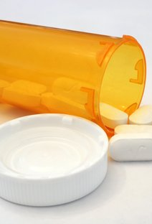
Treatment
Antibiotics
Antivirals
If you or your partner are infected-both need to receive treatment to avoid re-infecting each other
This Photo by Unknown Author is licensed under CC BY-ND
Notes:
Three bacterial-chlamydia, gonorrhoea and syphilis, and one parasitic-trichomoniasis- ATB,-gon is harder to treat d/t it becoming resistant to many antibiotics. herpes and HIV, the most effective medications available are antivirals that can decrease the course and symptoms of the disease, though they cannot cure the disease.- hepatitis B, antiviral medications can help to fight the virus and slow damage to the liver.

Slide 8
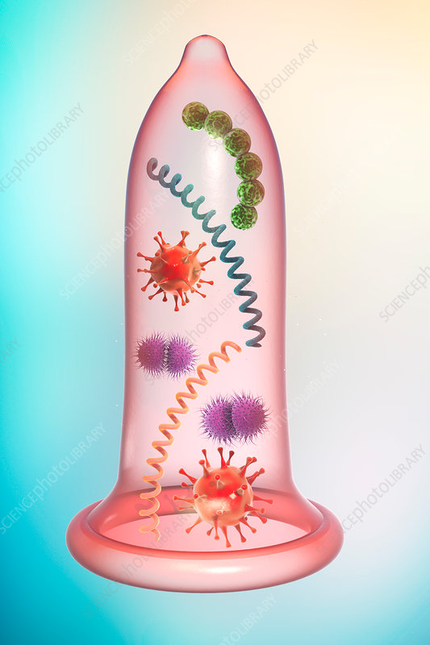
What can you do to protect yourself?
Abstinence
Vaccines
Reduce number of sexual partners
Mutual monogamy
Use condoms
Get tested
Notes:
Abst=means avoiding-abviously most realiable, HPV & hep B both have vaccines-series. HPV females (as early as 9) 12-26yo, males 13-21(up to26). Mono-only 1 person both agree to. Condoms-highly effective in reducing transmission when used for vaginal, anal and oral sex it is recommended that you be tested every year for STDs, or if a female becomes pregnant

Slide 9
References
Sexually Transmitted Disease (STD) Symptoms. Mayo Clinic. https://www.mayoclinic.org/diseases-conditions/sexually-transmitted-diseases-stds/in-depth/std-symptoms/art-20047081. Accessed September 8,2020.
Sexually Transmitted Diseases (STDs). Center of Disease Control and Prevention. https://www.cdc.gov/std/prevention/default.htm. Accessed September 8,2020.
Sexually Transmitted Infections (STIs). World Health Organization. https://www.who.int/news-room/fact-sheets/detail/sexually-transmitted-infections-(stis). Accessed September 8, 2020.

