Slide 1


Mononucleosis

Slide 2
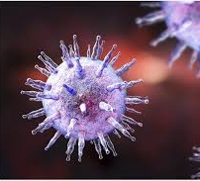
What is it?
It is an illness most commonly caused by contracting the Epstein-Barr Virus (EBV)
It is most common in teens and young adults
1:4 teens/young adults who get EBV will also get mono
The symptoms may not develop for 4-6 weeks after being infected.
Notes:
Commonly known as the kissing disease. Symptoms may develop slowly and not all at the same time. So lets talk about what those symptoms look like on the next slide

Slide 3
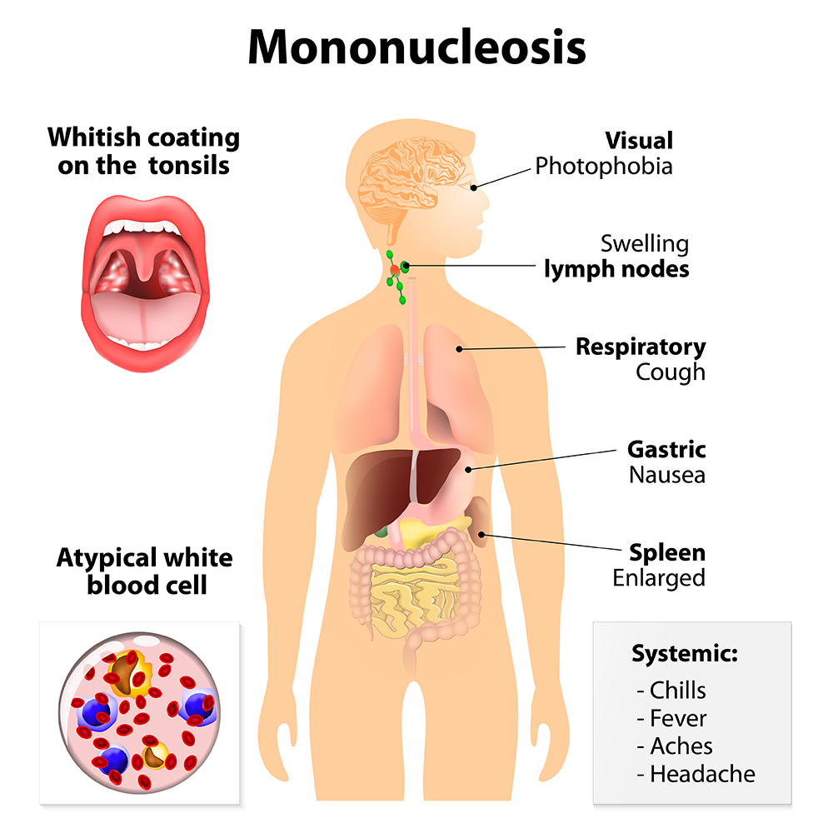
symptoms
Extreme fatigue
Sore throat & swollen tonsils
Fever
Swollen lymph nodes in your neck and armpits
Headache and body aches
Skin rash
Enlarged/swollen spleen and/or liver
Notes:
Sore throat sometimes misdiagnosed as strep throat, that doesn't get better after treatment with antibiotics(has similar swollen tonsils with white coating) (diagnosed usually just by symptoms but blood work may be drawn
Enlarged spleen and a swollen liver are less common symptoms. For some people, their liver or spleen or both may remain enlarged even after their fatigue ends.
Most people get better in two to four weeks; however, some people may feel fatigued for several more weeks. In rare occasions, the symptoms can last for six months or longer

Slide 4
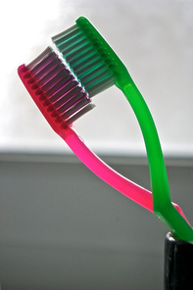
transmission
Coughing or sneezing.
Kissing.
Sexual contact.
Sharing food, drinks or eating utensils.
Sharing personal items. (like a toothbrush)
Notes:
Esp silivia – guess why known as kissing disease. This is with someone who has infectious mono. Its unlikely but also organ transplants and blood transfusions

Slide 5
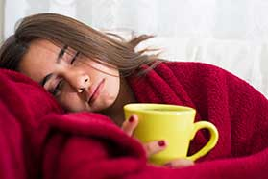
treatment
Rest
Hydrate
Use pain relievers
Throat soothing agents
Avoid contact sports or strenuous activity
Notes:
To prevent getting mono, Avoid doing these things with a person who you know has been diagnosed with mono-things we just talked about on previous slide on transmission. No vaccine. Antibiotics wont help treat mono, if you are given an antibiotic it is most likely for a secondary infection. The reason for no contact sports is bc of the chance of rupturing your spleen d/t the swelling. The spleen is an organ that helps filter blood so if it ruptures, you can have internal bleeding(which is a medical emergency). Also chance of a relapse if start back with activities too soon-recommended about 1 month

Slide 6
references
Epstein-Barr Virus and Infectious Mononucleosis. Centers for disease Control and Prevention. https://www.cdc.gov/epstein-barr/about-mono.html. Accessed October 12,2020.
Mononucleosis. Mayo Clinic. https://www.mayoclinic.org/diseases-conditions/mononucleosis/symptoms-causes/syc-20350328. Accessed October 13, 2020.
Mononucleosis: Treatment and Management. Cleveland Clinic. https://my.clevelandclinic.org/health/diseases/13974-mononucleosis/management-and-treatment. Accessed October 13,2020.

