Slide 1
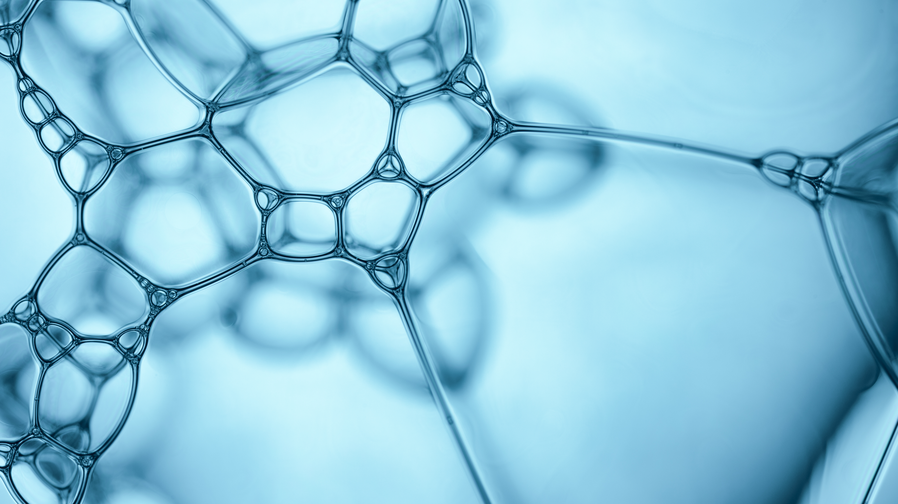

Meningitis

Slide 2
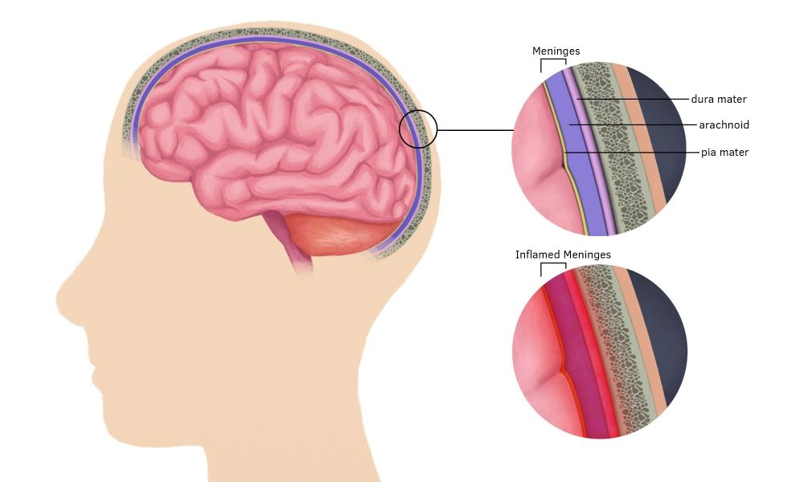
Meningitis is an inflammation of the membranes and fluid that surround the brain and spinal cord.
The swelling can cause headaches, fevers, and a stiff neck.
Infants and young adults, those with compromised immune system, those who have not gotten vaccines(when possible), living in a community type setting are most vulnerable.
Notes:
Headache can cause nausea or vomiting, sensitivity to light, symptoms might also include Confusion or difficulty concentrating, Seizures, Sleepiness or difficulty waking. Community-like college dorms, military bases, boarding school.
In the U.S., most cases are due to a viral infection, but there are other causes which will get into on the next slide

Slide 3
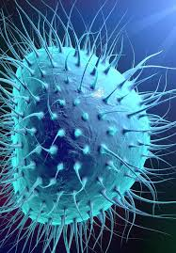
Bacterial
Bacterial meningitis is the most serious and requires medical attention immediately.
The bacteria can either enter the bloodstream and eventually reach your brain and spinal fluid or enter more directly by an ear or sinus infection.
It is treated with antibiotics.
There are different strains of bacteria that can cause bacterial meningitis, some of which have vaccines.
Notes:
A delay in treatment can cause permanent brain damage and even death. A skull fracture. Common in those ages 20 and under

Slide 4
Viral
Symptoms are usually more mild than bacterial, and it can clear up on its own.
Most people will recover within 7-10 days.
Enteroviruses are known to be the most common cause of viral meningitis in the U.S. and occurs more often in the late summer and early fall.
Other viruses like herpes, HIV, mumps, measles, influenza and West Nile can cause meningitis
Notes:
No treatment but vaccines to the other viruses like measles, mumps, influenza can prevent this type of transmission. Common in those under the age of 5

Slide 5
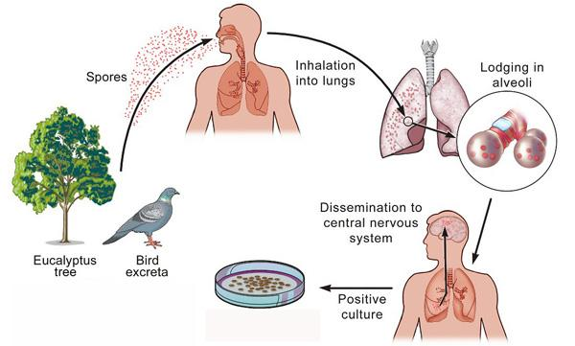
Fungal
Contracted by breathing in fungal spores from soil, bird/bat droppings, or decaying wood and leaves.
It is not contagious between people.
It can be treated with antifungal medication.
Notes:
Fungal-uncommon in US. Can have similar symptoms to that of bacterial. Cannot be transferred from person to person.

Slide 6
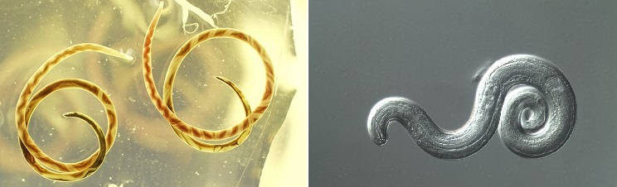
Parasitic
A rare type of meningitis.
It most common in animals, which is then transferred to humans who eat the contaminated animal.
It is not contagious between people.

Slide 7
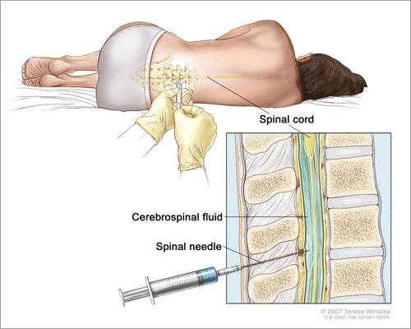
Ways to diagnose
Lumbar
Puncture
CT/MRI-scan to help show any swelling or inflammation in the brain/head
Blood cultures- samples of blood to help determine if any bacteria is involved
Notes:
collect cerebrospinal fluid (CSF). In people with meningitis, the CSF often shows a low sugar (glucose) level along with an increased white blood cell count and increased protein.

Slide 8
References
Meningitis: Diagnosis & Treatment. Mayo Clinic. https://www.mayoclinic.org/diseases-conditions/meningitis/diagnosis-treatment/drc-20350514. Accessed October 19,2020.
Meningitis. Centers for Disease Control and Prevention. https://www.cdc.gov/meningitis/index.html. Accessed October 20,2020.
Meningitis: Overview. World Health Organization. https://www.who.int/health-topics/meningitis#tab=tab_1. Accessed October 20, 2020.

