Slide 1


Food poisoning

Slide 2
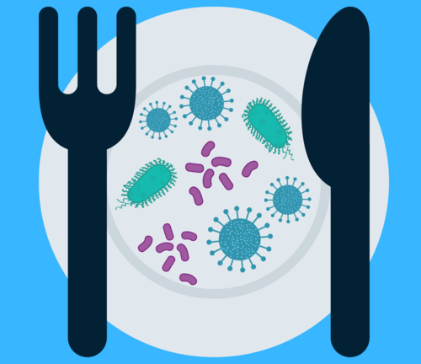
The details
Food poisoning is also called foodborne illnesses
It is commonly caused by consuming contaminated food that is infected by either a bacteria, virus, parasite or their toxins.
The contamination can happen at home or during the processing of the food by improper handling or cooking of the food.
Food poisoning usually starts within hours of ingesting the food and symptoms can range from mild to severe, occasionally leading to hospitalization.
Notes:
Can start days to weeks later.

Slide 3
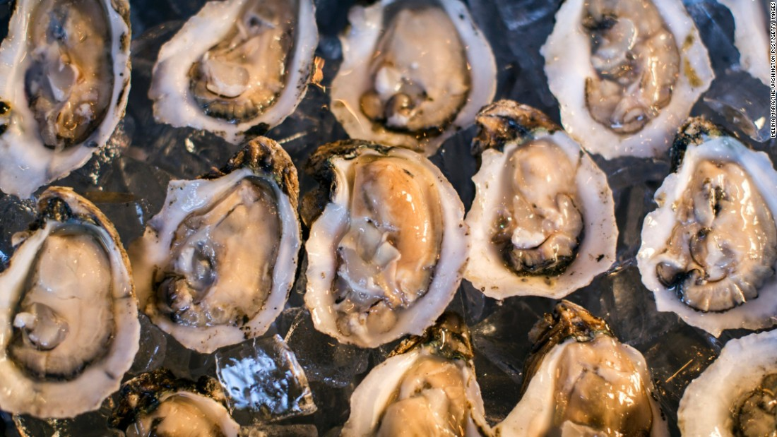
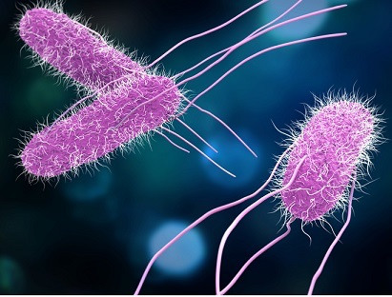
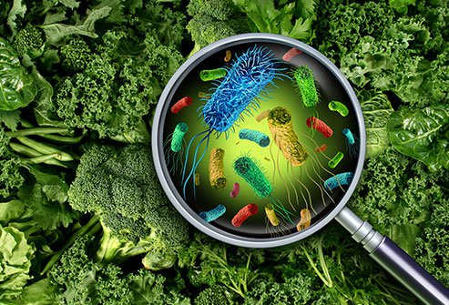
causes
E. coli.: 1-8 days for symptoms to start, mainly undercooked beef, unpasteurized milk/apple cider, and contaminated water
Salmonella: 1-3 days for symptoms to start, usually from undercooked or raw meat and egg yolks. Can be spread by cutting surfaces and knifes.
Cyclospora: up to 1 week before symptoms start, mainly from raw fruit, vegetables and herbs
Norovirus: 12-48 hours for symptoms to start, usually from raw or ready to eat produce or shellfish from contaminated water. Can be transferred by infected food handler.
Listeria: 9-48 hours for symptoms to start, found in hot dogs, lunch meat, unpasteurized milk/cheese, unwashed produce.
Campylobacter: 2-5 days for symptoms to start, main source comes from meat, poultry, unpasteurized milk. Also from animal feces coming in contact with the meat.
Notes:
Bc the food is uncooked, the organisms are not killed off. Cross contamination is usually the cause, specifically with raw/uncooked foods and produce norovirus-ready to eat(salads), shellfish--oysters

Slide 4
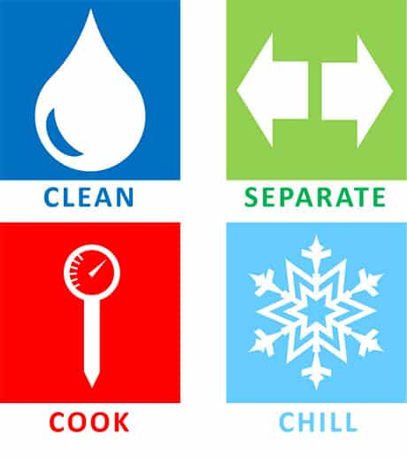
Prevention
Wash hands, cooking surfaces and utensils often
Keep raw foods separate
Use a thermometer to make sure food is thoroughly cooked
Freeze or place perishable foods in refrigerator within 2 hours
Defrost food carefully
Wash produce
Notes:
Raw foods(uncooked meats/fish) separate at all times to avoid cross contamination (shopping, storing and preparing), red meats 160 degrees, poultry 165 degrees, 2 hrs of preparing or bringing home from store, do not defrost on counter(room temp), best practice is to place in fridge

Slide 5
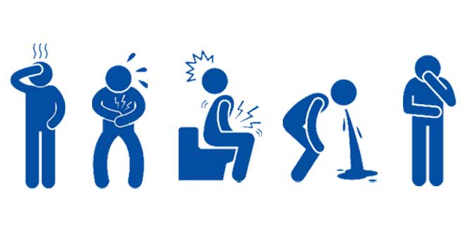

symptoms
Upset stomach
Nausea
Vomiting
Stomach cramping
Diarrhea
Fever
It’s important to report your symptoms to the local health department. It can help prevent an outbreak!
Notes:
Usually lasts hours to days-depends on what type of organism you consumed

Slide 6

When to see the doctor:
In you see blood in your bowel movements
A fever over 102 that doesn’t come down with Tylenol
Frequent vomiting that prevents liquids from staying down
Diarrhea that lasts for more than 3 days
Dehydration-dry mouth, feeling dizzy, decreased amount of urine
Notes:
The big thing to focus on here is the dehydration part. The vomiting and diarrhea can lead to dehydration pretty quickly so its important to monitor your intake. Treatment if needed would be iv hydration –replace fluid and electrolytes, antibiotics if bacterial –listeria. Otherwise more mild symptoms will clear on own.

Slide 7
References
Food Poisoning. Mayo Clinic. https://www.mayoclinic.org/diseases-conditions/food-poisoning/symptoms-causes/syc-20356230. Accessed November 3,2020.
Food Safety: Food Poisoning Symptoms. Centers for Disease Control and Prevention. https://www.cdc.gov/foodsafety/symptoms.html. Accessed November 3, 2020.
Food Poisoning. Food and Safety.gov. https://www.foodsafety.gov/food-poisoning. Accessed November 4,2020.
Food Safety in Your Kitchen. U.S. Food & Drug Administration. https://www.fda.gov/food/buy-store-serve-safe-food/food-safety-your-kitchen. Accessed November 4, 2020.

