Slide 1
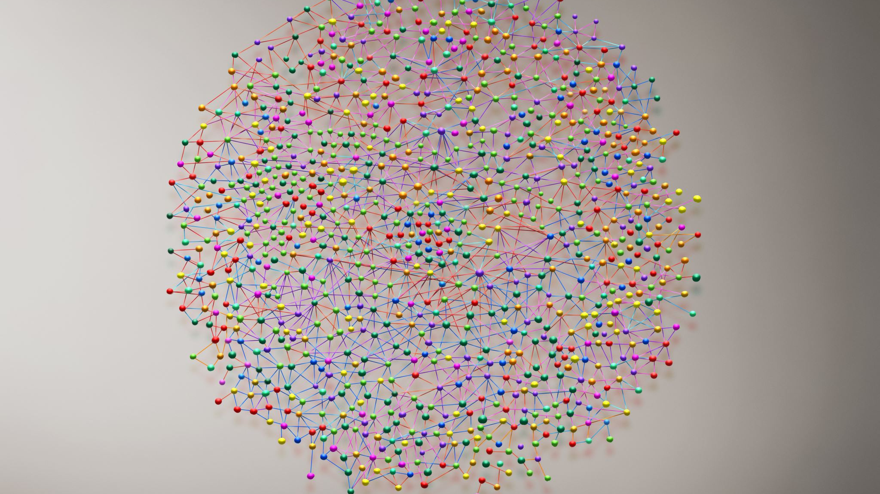


Eating Disorders

Slide 2
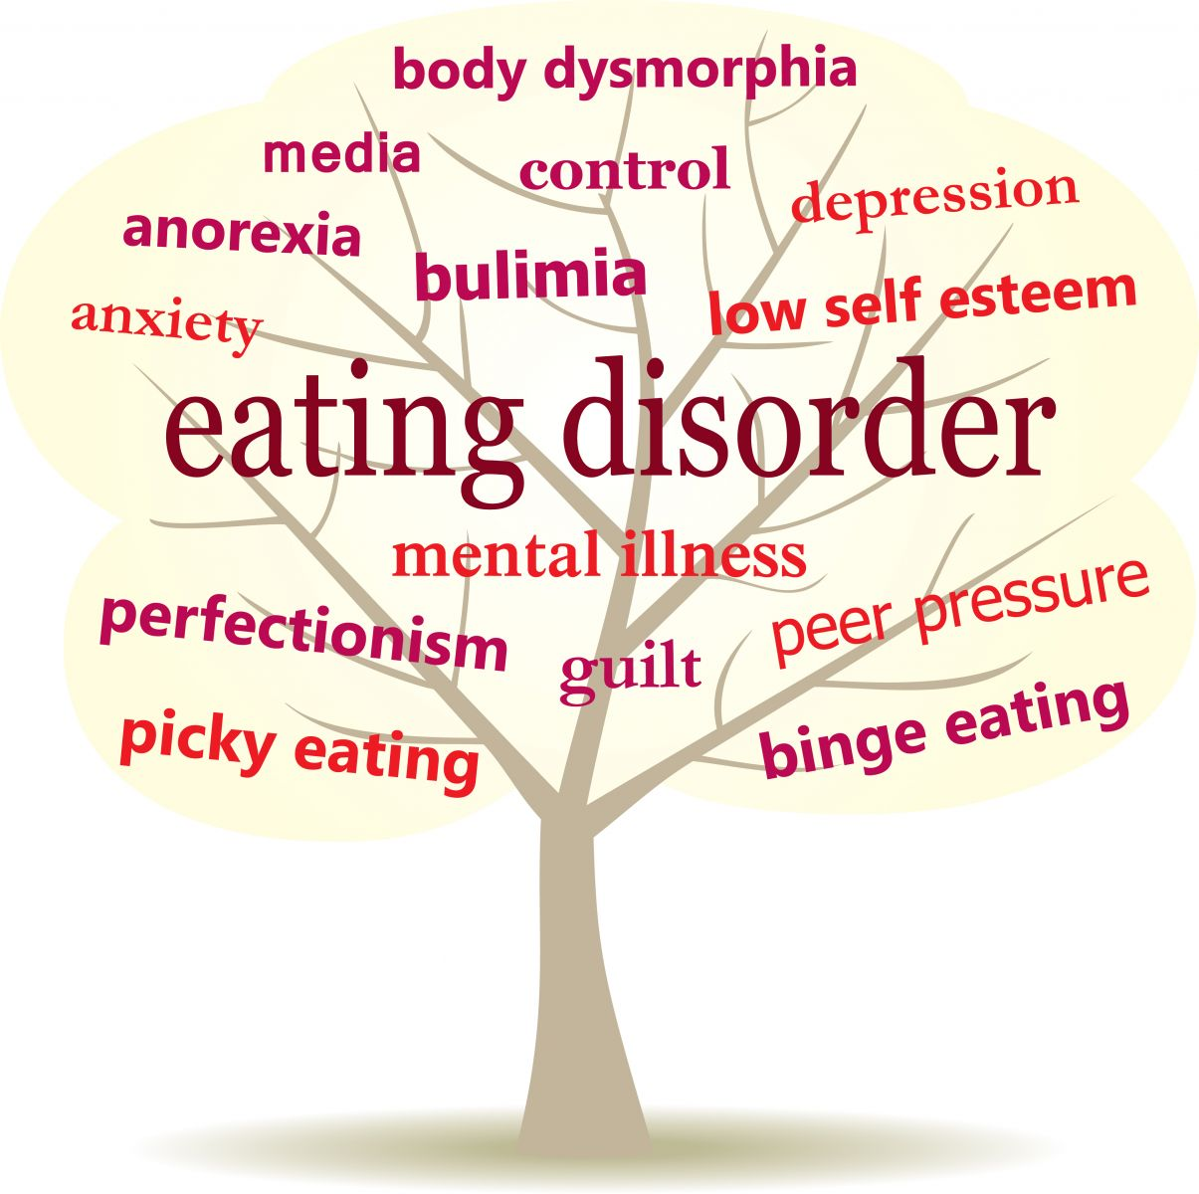
An Overview
Eating disorders are serious illnesses that are related to persistent eating behaviors that lead to a negative impact on your overall health, emotional state, and ability to function in important areas of one’s everyday life.
An eating disorder is a condition that is thought to be biological, psychological and emotionally related.
In the U.S. alone, it affects 20 million women and 10 million men at some point during their lives
Notes:
What causes the disorders are not known but . Self esteem issues, perfectionist behaviors, anxiety, stress, impulsive behaviors. (ocd) Its been known to develop primarily in teens and young adults (12-35)but can happen at any point during a lifespan.

Slide 3
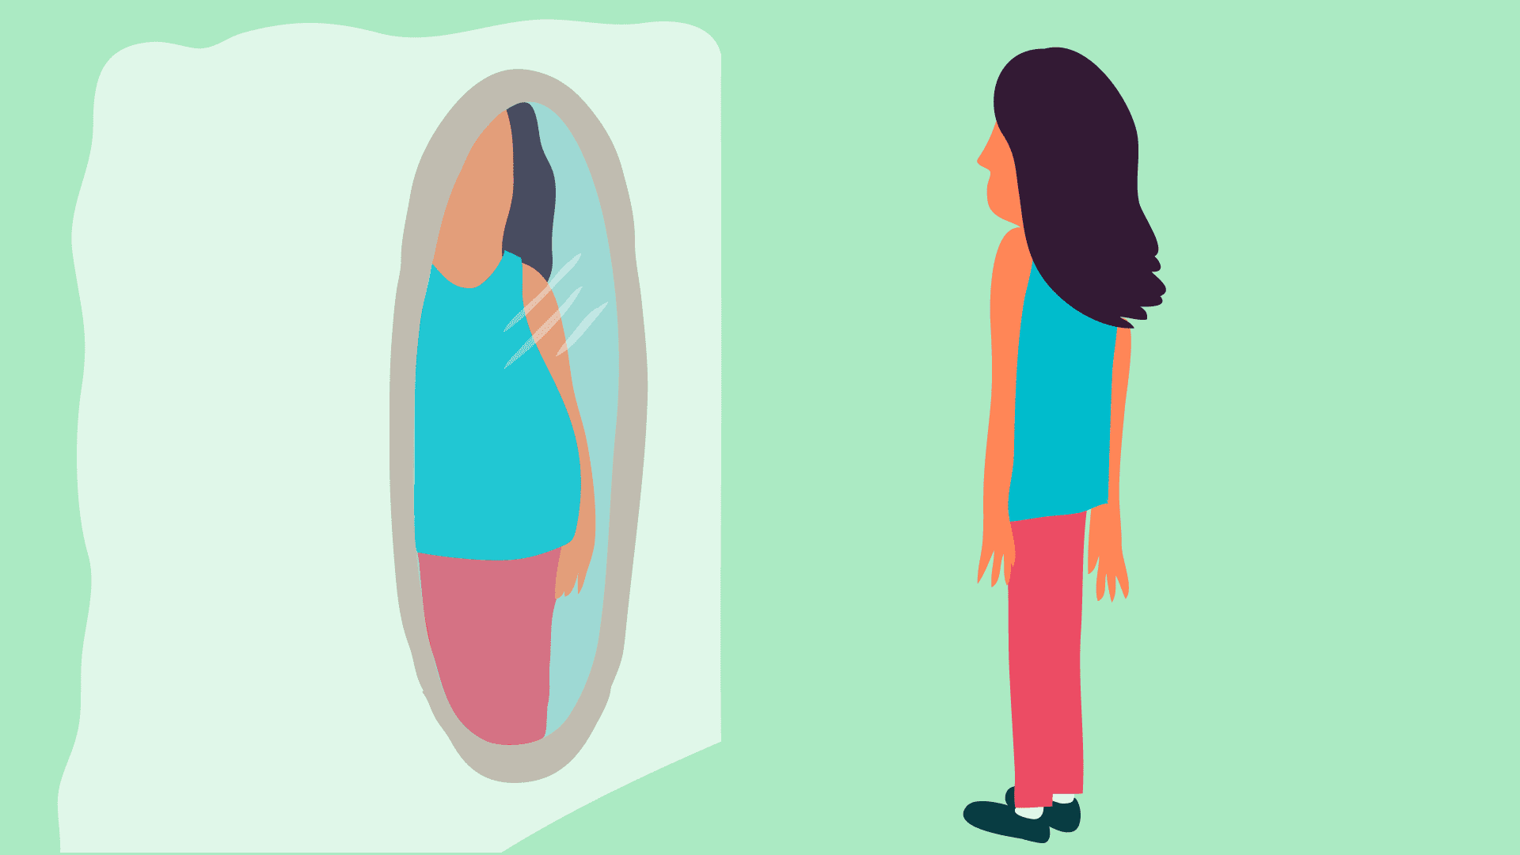

Anorexia Nervosa
15% less than normal, healthy body weight.
Extreme fear of gaining weight.
Distorted image of body weight or shape.
Fear of being “fat”.
May use extremes to control weight like severely limiting calories, excessive exercise, using laxatives beyond recommended use and taking diet aids.
Notes:
Menstrual periods to stop, osteoporosis (thinning of the bones) through loss of calcium, Hair/nails become brittle and thin, hair loss, Skin dries and can take on a yellowish color, muscles, including the heart muscle start to deteriorate, Severe constipation,( both d/t lack of nutrition and dependent on laxative use) Internal body temperature falls, causing person to feel cold all the time
Depression and lethargy

Slide 4
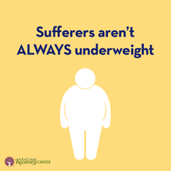

Bulimia Nervosa vs Binge Eating
Consists of episodes of binging and then purging.
Sometimes food is restricted during the day which can lead to more episodes
Feelings of guilt, shame, lack of control or an extreme fear of gaining weight from overeating are common
Regularly eating too much food
Quickly eating more than planned, even if not hungry
May have feelings of guilt or being ashamed over the amount of food eaten. Can lead to eating alone to hide the amount being eaten.
No extreme behaviors of exercise or purging
Notes:
These episodes involve eating a large amount of food in a short period
feeling a lack of control-drives the purging. To get rid of all the extra calories, important to note people who suffer from this can be of normal weight or even slightly over weight
These episodes occur at least once a week and even multiple times a day. Chronic sore throat(from irritation from throwing up), tooth decay again from the stomach acid taking off the tooth enamel. Dehydration from throwing up. People with this type are anywhere from normal wt to over weight or obese.

Slide 5

Avoidant/Restrictive Food Intake
Not meeting the minimum daily requirements for nutrients
Food is not avoided due to a fear of gaining weight
No interest in eating
or
Avoiding certain foods because of certain characteristics
or
Afraid of the potential reactions that coming with eating like choking
Notes:
color, texture, smell or taste

Slide 6
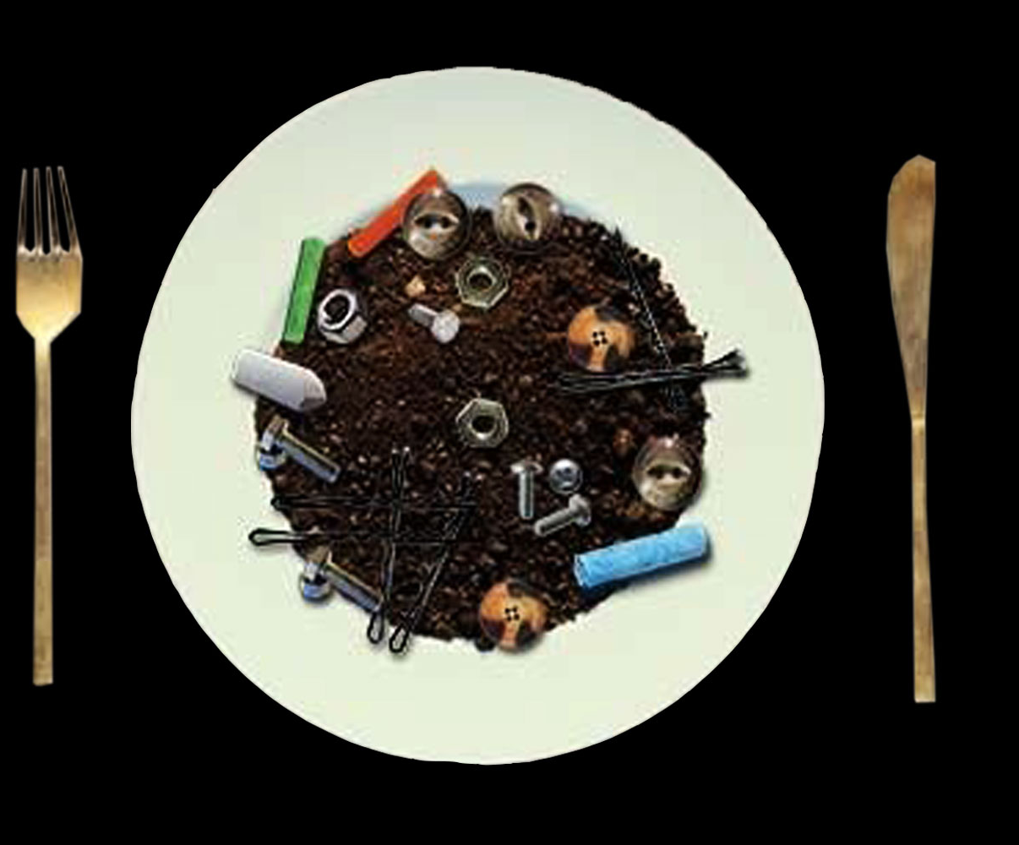
Pica
Eating non-food objects such as paper, soap, hair, chalk, soil, metal, clay and ice.
Can lead to blockages in the intestines or toxic side effects.
Most commonly linked to iron deficiency and malnutrition.
Can usually be treated with medications or vitamins.
Notes:
Happens more than 1 x a month More objects than listed. Also can happen during pregnancy. No food aversions. Can be some underlying mental health disorders like schizophrenia, being on the autism spectrum or having a intellectual delay.

Slide 7


Laxative Abuse and Compulsive Exercise
Concerning when it starts to interfere with important activities, withdrawing from family and friends or continues even when an injury occurs.
It may be used as a way to allow one's self to be able to eat.
May become secretive about how much exercise is taking place.
When laxatives are used too frequent and for the wrong reasons.
Attempt to get rid of extra calories before they are absorbed by quickly expelling them from the body.
Can be dangerous and cause serious harm to the body.
Notes:
Usually after a binge episode. Electrolytes and minerals like sodium, potassium, magnesium are pulled from the body, too little of these can cause heart rhythm issues along with many other serious problems. Dehydration is also a big issue bc water is also removed from the body-can cause blurry vision and weakness, passing out-more extreme kidney damage. Need medical treatment to re hydrate. exercise- as if giving permission.

Slide 8
Reach Out for Help
MSJC
Our mental health counselors are available by calling 951-732-7970 or logging into the student health patient portal to schedule an appointment.
Valenta, Inc. (909) 771-8023 Provides treatment to assist individuals struggling with Anorexia Nervosa, Bulimia Nervosa and various forms of these illnesses and combines medical and therapeutic treatments.
NEDA (National Eating Disorder Association)
For crisis situations, text NEDA to 741741 to be connected with a trained volunteer.
Notes:
Important to seek treatment . These disorders are difficult to overcome by yourself. If left untreated they can take over your whole life and can lead to serious complications or even death

Slide 9
References
Eating Disorders:0verview. Mayo Clinic. https://www.mayoclinic.org/diseases-conditions/eating-disorders/symptoms-causes/syc-20353603. Accessed September 28,2020.
What Are Eating Disorders? American Psychiatric Association. https://www.psychiatry.org/patients-families/eating-disorders/what-are-eating-disorders. Accessed September 29,2020.
Information By Eating Disorders. National Eating Disorder Association. https://www.nationaleatingdisorders.org/information-eating-disorder. Accessed September 28, 2020.

Slide 10


Contact Us:
Phone: (951) 732-7970
HealthServices@msjc.edu
www.msjc.edu/healthcenter/
Follow us on Social Media @MSJChealth

