Slide 1


Bruises, Sprains and Strains
What is the difference?

Slide 2
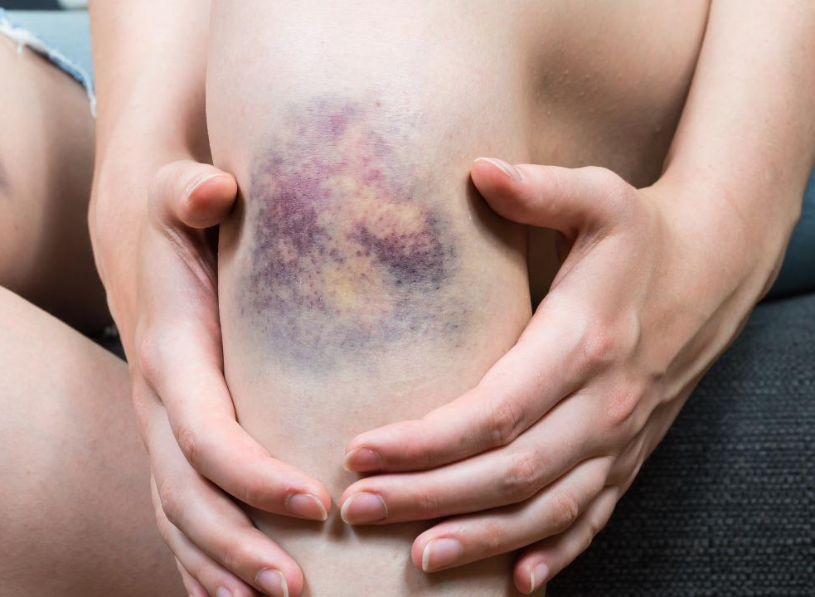
Bruises(contusion)
A bruise is an injury to the tissue that causes blood vessels to break and bleed into the tissue.
The trapped blood causes the skin to turn purple/red initially then as it fades, the color changes to yellow/green.
Notes:
Sometimes bone or muscle.

Slide 3
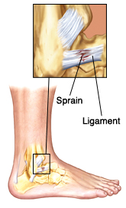
Sprains
A sprain is an injury to the ligaments-tissue that connects one bone to another bone.
The injury is usually due to a over stretched or tear to the ligament by actions like twisting a knee or rolling of the ankle.
Pain, swelling, bruising and limited range of motion to the joint may be noticed

Slide 4
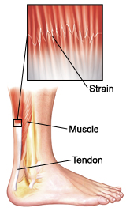
Strains
A strain is an injury to the muscle and tendons (tissue that attaches muscle to bone) caused by sudden pulling or over stretching.
A sprain can happen abruptly or over several days/weeks.
Most are caused by overusing a muscle and lifting heavy objects the wrong way.
Pain, swelling, muscle spasms, cramping and muscle weakness may be noticed.
Notes:
You can also get RSI (repetitive strain injury) by doing the same movement continuously.

Slide 5
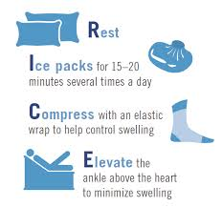
Treatment
While the symptoms of a sprain and strain are similar, the location will be different. The sprain will occur along the joint and the strain will be over a muscle.
R.I.C.E.-rest, ice, compress and elevate
Physical therapy
In some severe cases, surgery is needed
Notes:
The sooner you start rice, the quicker the healing process- limits swelling and pain. Can do this for a bruise as well. Ice 4-8x a day. Compress-tightest away from heart. 1-2 days then you should start to notice improvement-start light activity to prevent stiffness. Otc meds like ibuprofen can help

Slide 6
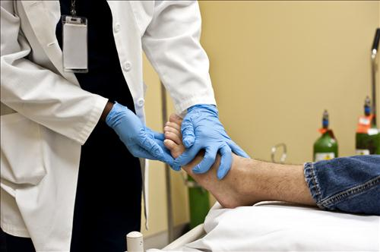
When to seek medical attention
Bruise:
still having pain more than 3 days after initial injury
notice a bump under the bruise
painful swelling over bruised area
Sprain & Strains:
unable to put weight on joint
numbness around injury
pain over the bone of injured joint
Notes:
If you have tried RICE and not getting better… bump-could be hematoma

Slide 7
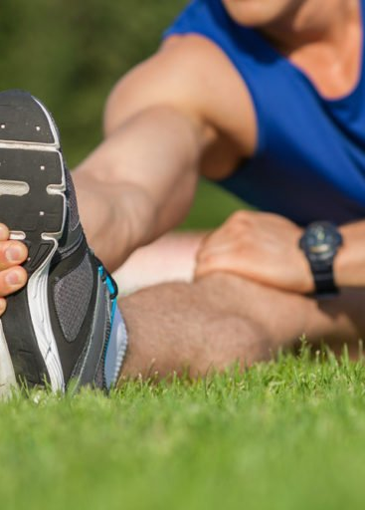
Prevention
doing consistent stretching and strengthening exercises to keep the muscles strong around the joints.
wear shoes that offer support and joint protection.
warm up before physical activity.
Notes:
If participating in a sport activity-make suer to wear the appropriate protective gear. Mainly applies to strains and sprains. Not much to prevent bruising except avoid falls ect

Slide 8
References
Sprains. Mayo Clinic. https://www.mayoclinic.org/diseases-conditions/sprains/symptoms-causes/syc-20377938#:~:text=The%20difference%20between%20a%20sprain,a%20muscle%20to%20a%20bone. Accessed November 9,2020.
Bruise: First aid. Mayo Clinic. https://www.mayoclinic.org/first-aid/first-aid-bruise/basics/art-20056663. Accessed November 10,2020.
Sprains, Strains and Contusions How to Recognize and Prevent the Aches and Pains in Most Common to Athletic Play. Triffon, Mark J. MD. https://www.orthopedicone.com/news-events/sprains-strains-and-contusions-how-to-recognize-and-prevent-the-aches-and-pains-most-common-to-athletic-play. Accessed November 9, 2020.
Sprains and Strains. National Institute of Arthritis and Musculoskeletal and Skin Diseases. https://www.niams.nih.gov/health-topics/sprains-and-strains#tab-treatment. Accessed November 12,2020.

