Slide 1



Asthma

Slide 2
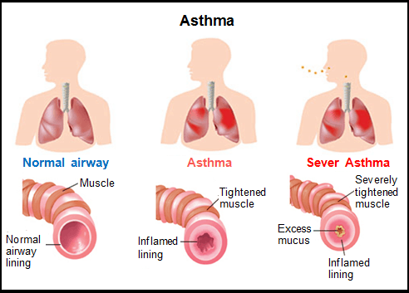
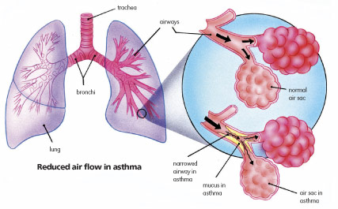
What is asthma?
Asthma is a chronic disease that involves the airway into the lungs
The airway (bronchial tubes) can become swollen and the muscle around the airway tightens. The result is a narrowed airway
Notes:
Even thought asthma is a chronic illness, meaning that it will never go away, it can be managed and you may only have flares where it is worse for short periods of time. Asthma affects more than 25 million americans . It is especially hard for air to be pushed back out of the lungs

Slide 3
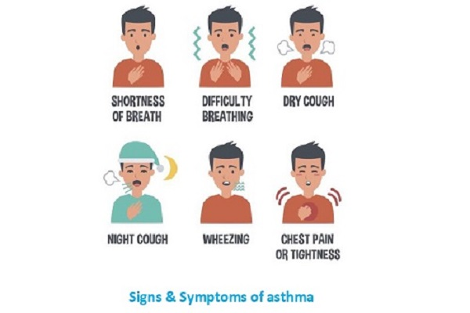
Symptoms
Wheezing
Coughing
Shortness of breath
Chest tightness
Increased rate of breathing
Notes:
Wheezing is almost like a whistling/squeaking sound. Cough is usually dry-but mucous is sometimes present with asthma symptoms, which also obstructs the airway. Increased rate d/t not getting the sufficient air flow Symptoms tend to get worse at night d/t changes in body hormones and natural body rhythm changes

Slide 4

Different types
Exercise induced asthma (EIA)-symptoms occur with exercise
Occupational- triggered from airborne substances while working
Allergic- triggered by common allergens in the air
Childhood- asthma symptoms that occur before the age of 5
Notes:
Exercise- may be worse with cold/dry air, occupational- substances like fumes, dust gases, etc, Allergic- pollen, dust, mold spores, pet dander-those with a family hx of allergies or asthma are more prone
Along with different types, there are different levels ranging from mild and intermittent to severe and persistent –this depends on how often you have symptoms

Slide 5
Triggers
Allergy symptoms
Exercise
Smoke/air pollution/strong smells and fumes
Emotional stress/anxiety
Certain medications(aspirin/NSAIDS, beta blockers)
Infections –viral and bacterial
Exposure to cold, dry air or severe weather changes
Acid reflux
Notes:
As you can see, we talked about a lot of these triggers already on the previous slide. The triggers tend to go hand in hand with type of asthma. Nsaids-ibuprofen, beta blockers-used for blood pressure along with other uses

Slide 6
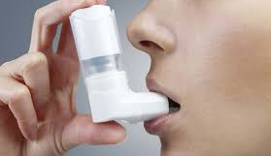
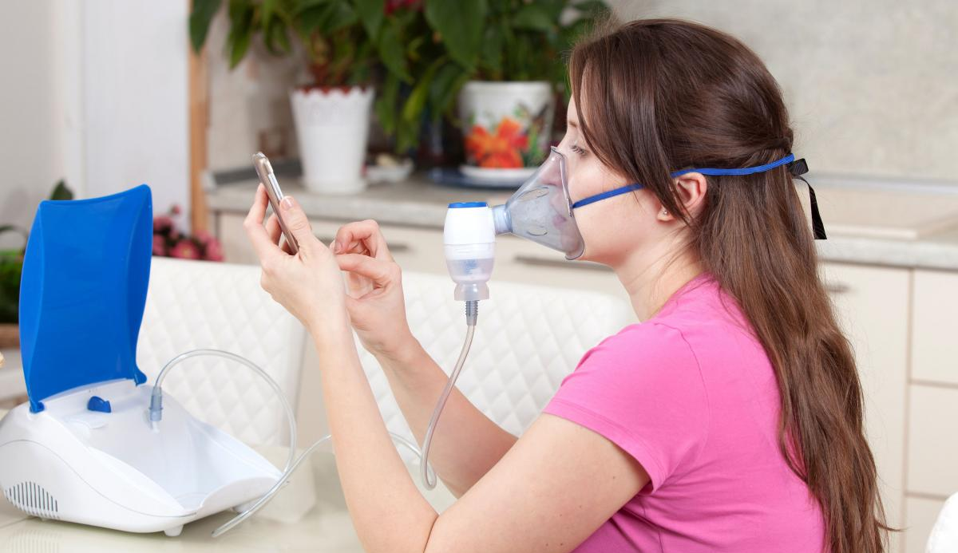
Treatment options/symptom management
Quick relief: bronchodilators(open up the airway)
Inhalers and nebulizers
Vs
Long term control: medications taken daily to help control inflammation for those with frequent symptoms.
Notes:
Bronchdilators are short acting. They will treat the symptoms but not the underlying airway problem that caused the symptoms(like those during an asthma attack) struggling to catch your breath, chest tightness and breathing rate increases suddenly. Long term-inhalers are different medications as the short acting, injections, pills

Slide 7




What to expect during your doctor visit
To help diagnose asthma, you may need to have one or more of the following:
a general physical exam
lung function test
X-ray of the chest
Allergy test
Notes:
If you find you are having symptoms as talked about, make an appointment to see your doctor. A lung function test measures how well you are able to expel or push air out of your lungs. They may recommend an allergy test to help identify triggers

Slide 8
references
Asthma. Mayo Clinic. https://www.mayoclinic.org/diseases-conditions/asthma/symptoms-causes/syc-20369653. Accessed Aug 24,2020.
Asthma-Conditions and Treatments. American Academy of Asthma, Allergy & Immunology. https://www.aaaai.org/conditions-and-treatments/asthma. Accessed Aug 24, 2020.
Asthma symptoms. Asthma and Allergy Foundation of America. https://www.aafa.org/asthma-symptoms/. Accessed Aug 26,2020.

Slide 9


Ph: (951) 732-7970 | HealthServices@msjc.edu | www.msjc.edu/healthcenter/
Follow us on Social Media @MSJChealth

